Slide 1

SWE 425: Telecommunication Engineering
Md. Habibur Rahman
Lecturer, Department of Software Engineering

Slide 2
Transmission Control Protocol (TCP)
The Transmission Control Protocol (TCP) is one of the main protocols of the Internet protocol suite.
It originated in the initial network implementation in which it complemented the Internet Protocol (IP). Therefore, the entire suite is commonly referred to as TCP/IP.
TCP provides reliable, ordered, and error-checked delivery of a stream of octets between applications running on hosts communicating by an IP network.
Major Internet applications such as the World Wide Web, email, remote administration, and file transfer rely on TCP.

Slide 3
Characteristics of TCP Protocol
Connection-oriented, point-to-point protocol:
Connection establishment and teardown phases
‘Phone-like’ circuit abstraction (application-layer view)
One sender, one receiver
Called a “reliable byte stream” protocol
General purpose (for any network environment)
Originally optimized for certain kinds of transfer:
Telnet (interactive remote login)
FTP (long, slow transfers)
Web is like neither of these!

Slide 4
Characteristics of TCP Protocol
application
application
socket
writes data
reads data
socket
layer
TCP
TCP
layer
send buffer
data segment
receive buffer
ACK segment
Provides a reliable, in-order, byte stream abstraction:
Recover lost packets and detect/drop duplicates
Detect and drop corrupted packets
Preserve order in byte stream, no “message boundaries”
Full-duplex: bi-directional data flow in same connection
Flow and congestion control:
Flow control: sender will not overwhelm receiver
Congestion control: sender will not overwhelm the network
Sliding window flow control
Send and receive buffers
Congestion control done via adaptive flow control window size

Slide 5
Challenges of Reliable Data Transfer
Over a perfectly reliable channel
All of the data arrives in order, just as it was sent
Simple: sender sends data, and receiver receives data
Over a channel with bit errors
All of the data arrives in order, but some bits corrupted
Receiver detects errors and says “please repeat that”
Sender retransmits the data that were corrupted
Over a lossy channel with bit errors
Some data are missing, and some bits are corrupted
Receiver detects errors but cannot always detect loss
Sender must wait for acknowledgment (“ACK” or “OK”)
… and retransmit data after some time if no ACK arrives

Slide 6
ADVANTAGES OF TCP
TCP always guarantees three things - your data reaches its destination, it reaches there in time and it reaches there without duplication.
In TCP, since all the work is done by the operating system, so you just need to sit back and watch the show. Even the debugging is taken care of by your OS.
It automatically breaks up data into packets for you.
The operating system does all the work. you just sit back and watch the show. no need to have the same bugs in your code that everyone else did on their first try; it's all been figured out for you.
Routers may notice TCP packets and treat them specially. they can buffer and retransmit them.
TCP has good relative throughput on a modem or a LAN.

Slide 7
DISADVANTAGES OF TCP
It is slower in functioning than UDP.
Since, all the work is being done by your OS, so if there are bugs in your OS, then you will face many problems like problems in surfing and downloading contents from the net.
TCP cannot be used for broadcast and multicast connections
TCP bandwidth, high latency link, such as a satellite connection or an overfull t1.
TCP cannot conclude a transmission without all data in motion being explicitly acknowledged.

Slide 8
TCP Segment Structure
32 bits
URG: urgent data
(generally not used)
counting
by bytes
of data
(not segments!)
source port #
dest port #
sequence number
ACK: ACK #
valid
acknowledgement number
head
len
not
used
U
Receive window
A
P
R
PSH: push data now
(generally not used)
S
F
# bytes
rcvr willing
to accept
checksum
Urg data pnter
RST, SYN, FIN:
connection estab
(setup, teardown
commands)
Options (variable length)
application
data
(variable length)
Internet
checksum
(as in UDP)

Slide 9
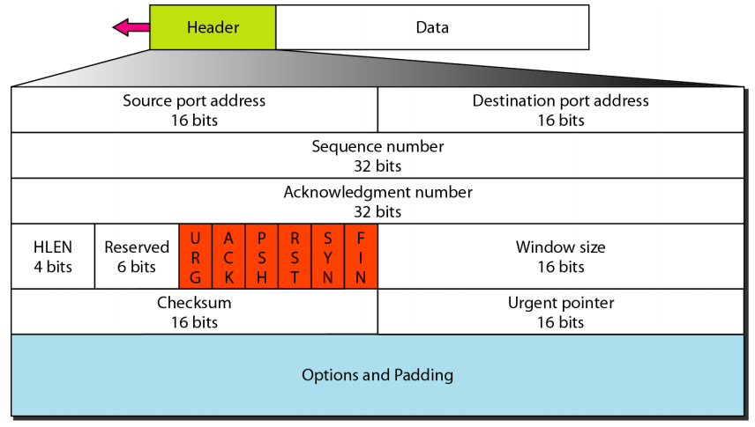
TCP Segment Structure

Slide 10
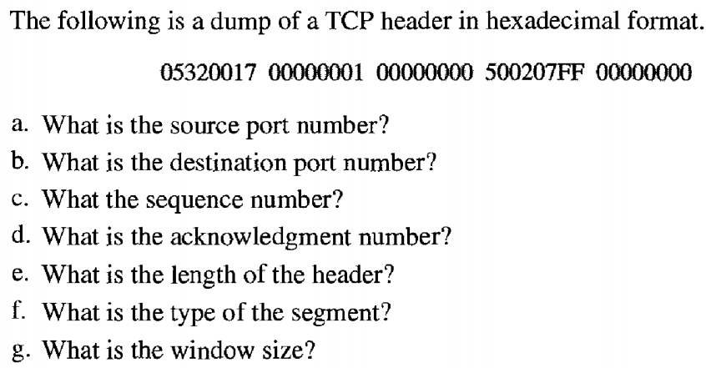
Example 1

Slide 11
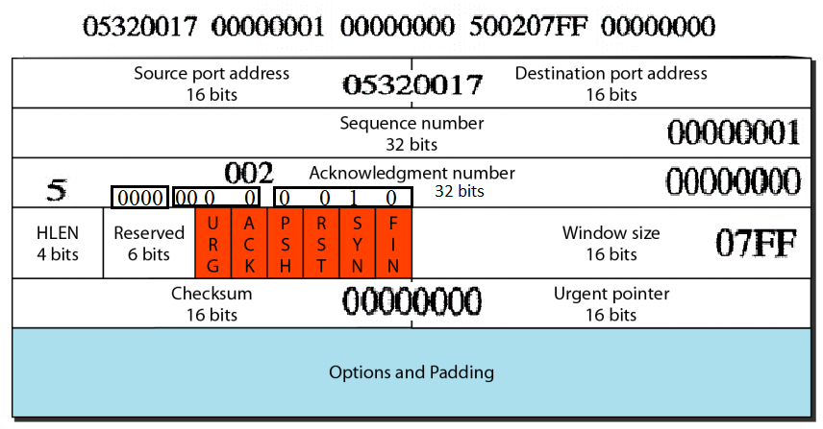
Example 1: Solution

Slide 12
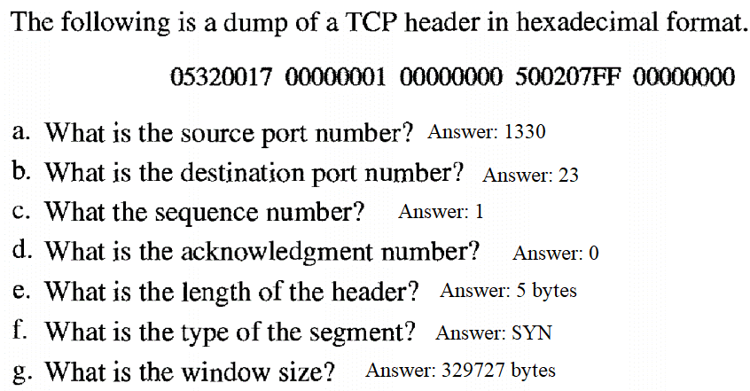
Example 1: Solution (Cont.)

Slide 13
Connection Establishment (cont)
Three way handshake:
Step 1: client host sends TCP SYN segment to server
specifies a random initial seq #
no data
Step 2: server host receives SYN, replies with SYNACK segment
server allocates buffers
specifies server initial seq. #
Step 3: client receives SYNACK, replies with ACK segment, which may contain data
Host A
Host B
Connection
request
SYN, Seq=42
host ACKs and selects
its own initial seq #
SYN+ACK, Seq=79, ACK=43
host ACKs
ACK, Seq=43, ACK=80
time
time
Three-way handshake

Slide 14
Connection Establishment (cont)
Host A
Host B
Connection
request
Seq. #’s:
byte stream “number” of first byte in segment’s data
ACKs:
seq # of next byte expected from other side
cumulative ACK
SYN, Seq=42
host ACKs and selects
its own initial seq #
SYN+ACK, Seq=79, ACK=43
host ACKs
ACK, Seq=43, ACK=80
time
time
Three-way handshake

Slide 15
TCP Connection Termination
Closing a connection:
client closes socket: clientSocket.close();
Step 1: client end system sends TCP FIN control segment to server
Step 2: server receives FIN, replies with ACK. Server might send some buffered but not sent data before closing the connection. Server then sends FIN and moves to Closing state.
client
server
close
FIN
ACK
DATA
Data
write
ACK
FIN
close
timed wait
ACK
closed

Slide 16
TCP Connection Termination
Step 3: client receives FIN, replies with ACK.
Enters “timed wait” - will respond with ACK to received FINs
Step 4: server, receives ACK. Connection closed.
Why wait before closing the connection?
If the connection were allowed to move to CLOSED state, then another pair of application processes might come along and open the same connection (use the same port #s) and a delayed FIN from an earlier incarnation would terminate the connection.
client
server
closing
FIN
ACK
closing
FIN
ACK
timed wait
closed
closed

Slide 17
TCP Retransmissions

Slide 18
Automatic Repeat reQuest (ARQ)
Automatic Repeat Request
Receiver sends acknowledgment (ACK) when it receives packet
Sender waits for ACK and timeouts if it does not arrive within some time period
Sender
Receiver
Packet
Timeout
ACK
Time

Slide 19
Reasons for Retransmission
Packet
Packet
Packet
Timeout
Timeout
ACK
Timeout
ACK
Packet
Packet
Packet
ACK
Timeout
Timeout
Timeout
ACK
ACK
Packet lost
ACK lost
DUPLICATE PACKET
Early timeout
DUPLICATE PACKETS
Notes:
Application may get duplicates in the case of early timeouts

Slide 20
TCP vs UDP
 | TCP | UDP
Acronym for | Transmission Control Protocol | User Datagram Protocol or Universal Datagram Protocol
Connection | TCP is a connection-oriented protocol. | UDP is a connectionless protocol.
Function | As a message makes its way across the internet from one computer to another. This is connection based. | UDP is also a protocol used in message transport or transfer. This is not connection based which means that one program can send a load of packets to another and that would be the end of the relationship.
Usage | TCP is suited for applications that require high reliability, and transmission time is relatively less critical. | UDP is suitable for applications that need fast, efficient transmission, such as games. UDP's stateless nature is also useful for servers that answer small queries from huge numbers of clients.
Ordering of data packets | TCP rearranges data packets in the order specified. | UDP has no inherent order as all packets are independent of each other. If ordering is required, it has to be managed by the application layer.
Speed of transfer | The speed for TCP is slower than UDP. | UDP is faster because error recovery is not attempted. It is a "best effort" protocol.
Reliability | There is absolute guarantee that the data transferred remains intact and arrives in the same order in which it was sent. | There is no guarantee that the messages or packets sent would reach at all.
Header Size | TCP header size is 20 bytes | UDP Header size is 8 bytes.

Slide 21
TCP vs UDP (continued…)
 | TCP | UDP
Streaming of data | Data is read as a byte stream, no distinguishing indications are transmitted to signal message (segment) boundaries. | Packets are sent individually and are checked for integrity only if they arrive. Packets have definite boundaries which are honored upon receipt, meaning a read operation at the receiver socket will yield an entire message as it was originally sent.
Weight | TCP is heavy-weight. TCP requires three packets to set up a socket connection, before any user data can be sent. TCP handles reliability and congestion control. | UDP is lightweight. There is no ordering of messages, no tracking connections, etc. It is a small transport layer designed on top of IP.
Data Flow Control | TCP does Flow Control. TCP requires three packets to set up a socket connection, before any user data can be sent. | UDP does not have an option for flow control
Error Checking | TCP does error checking and error recovery. Erroneous packets are retransmitted from the source to the destination. | UDP does error checking but simply discards erroneous packets. Error recovery is not attempted.
Acknowledgement | Acknowledgement segments | No Acknowledgment
Handshake | SYN, SYN-ACK, ACK | No handshake (connectionless protocol)

Slide 22
Thank You !!!
Any Questions ???

